Slide 1
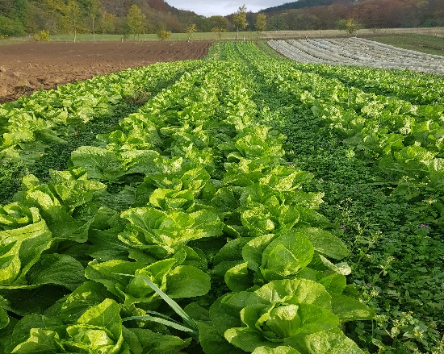
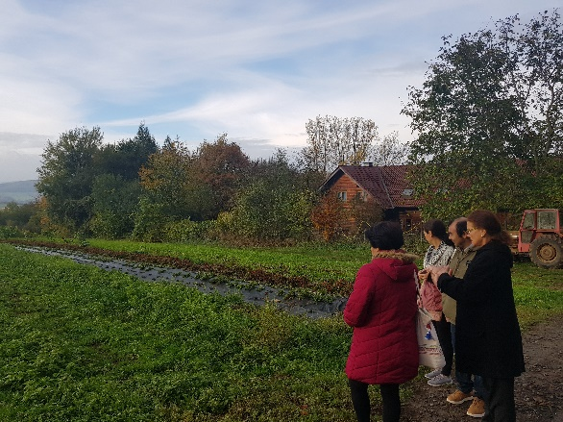
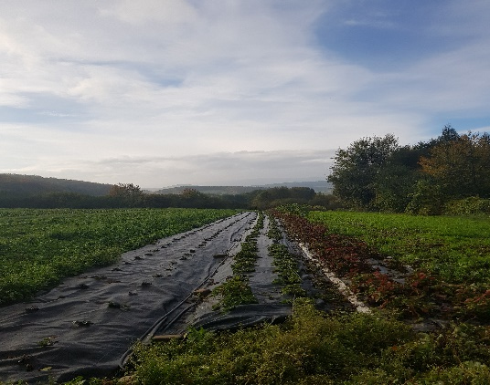
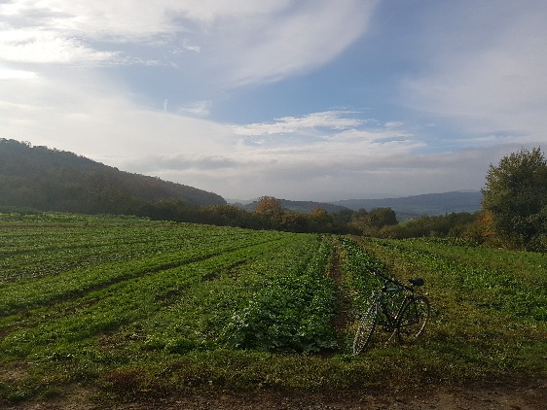
ICDD receives the visit of Economic Development Professors from Universidad Autonoma de Yucatan, Mexico
From 23rd to 27th of October, ICDD received the visit of Professors Alba Rivera, Rafael Ortiz and Lilian Mendoza, from the Department of Economics of Universidad Autonoma de Yucatan. The professors are engaged in projects and studies about sustainable economic development in agriculture focused on ecological productions in Mexico.
During the week, our guests attended meetings and lectures with ICDD researchers about fair trade and ecological agriculture, visited local shops and markets of organic goods produced by sustainable chains and took a tour through the organic farm of Grüner Bote (Green Messenger), one of the pioneers of German organic delivery services, in operation since 1986. All the organic vegetables are grown on the farm by undertaking sustainable practices. Other items are acquired from regional small producers and partners, involving an extensive range of 2000 organic goods available to be purchased.

Slide 2
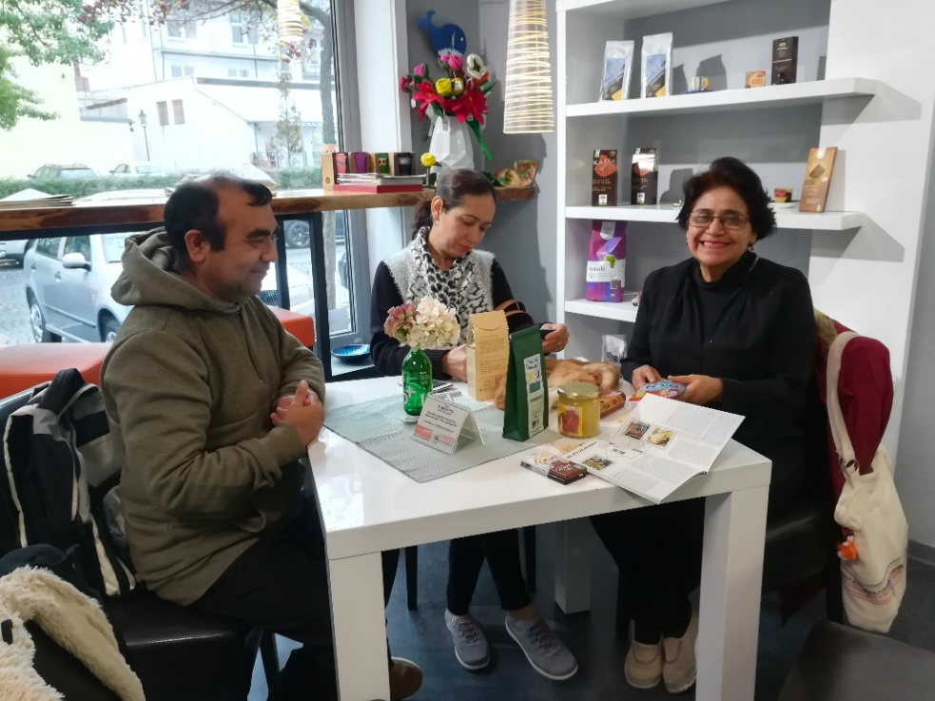
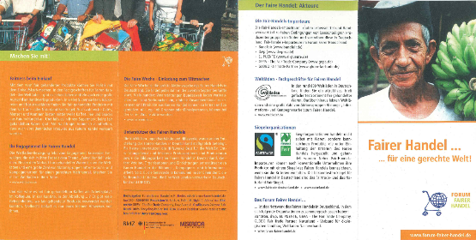
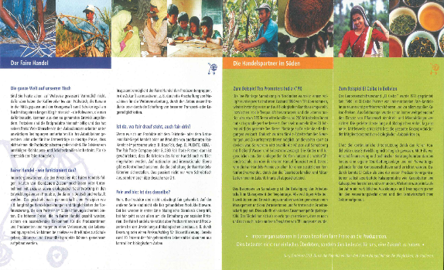
One of the shops our guests visited is the "Karibu Weltladen und Regionalladen Kassel“. This is a world and regional shop products that were produced on fair working conditions: food and craft from all over the world - and especially from the region. The majority of their products is also certified organic. The other shop they visited is the “Schmackes Bioladen”, which is focused on local products, buying products from regional cooperatives and local farming associations – where good work conditions are guaranteed.
In this experience, Professors Alba Rivera, Rafael Ortiz and Lilian Mendoza could exchange their experiences from Mexico and understand how a local shop in Kassel manage to deal with the cost of fair and biological products and in parallel keeping the interest and affordable prices for its customers. One of the conclusion of this discussion was the importance of including the theme into the educational system, in order to bring consciousness to future consumers around the world.

