Slide 1
Sightseeing in the German Academic Culture

Slide 2
Sightseeing in the German academic culture
Your guide:
Tour length: hours
2

Slide 3
Tour map
Start
Lecture
Seminar
Discussion
Group Work
Written Exam
Term Paper
End
Presentation
3

Slide 4
Sightseeing in the German academic culture
You’ll see:
what lies ahead of you at German universities,
why this can be useful for you,
which skills you’ll develop, and
how you can handle the German academic culture even better.
4

Slide 5
Start: Knowing me knowing you…
5

Slide 6
Task 1. Knowing me knowing you…
The classes were mostly lecturer-centered.
The lecturer systematically presented his professional knowledge.
The students took notes and tried to memorize what was said.
6

Slide 7
Task 1. Knowing me knowing you…
The lecturer was considered to be the central and unquestionable source of knowledge. Therefore, the contents of the lectures were not open to debate and the students never questioned or criticized what was said.
7

Slide 8
Task 1. Knowing me knowing you…
The learning material was not only presented by the lecturer but often also by the students. For that, the students had to work out the material on their own.
8

Slide 9
Task 1. Knowing me knowing you…
There often were discussions in which the students could take part actively and comment on the subject matter critically. The lecturer often asked the students questions and invited them to express their own opinion or take part in discussions.
9

Slide 10
Task 1. Knowing me knowing you…
There was plenty of opportunity to do group or partner work with other students inside and outside of the classes.
10

Slide 11
Task 1. Knowing me knowing you…
The lecturer got involved in subject-specific discussions with the students. The students could comment critically on the contents presented by the lecturer.
11

Slide 12
Types of classes at German universities: Lectures/seminars
Seminar
Lecture
12

Slide 13
Lecture
13

Slide 14
Lecture
Lecturer-centered class
Introduction to a scientific field
Lecturer:
presentation
Students:
listen
take notes
ask questions where appropriate
Necessary skills:
listening
note taking
14

Slide 15
Seminar
Lecture
Seminar
15

Slide 16
Seminar: A lot of talking
In-depth dealing with a topic
Scientific discussions
Active participation of the students
Participation in discussions
Working in groups
Giving a presentation
Lecturers support the students in learning.
The students share responsibility for the quality of the seminar.
16

Slide 17
Academic Quarter (“Akademisches Viertel”)
Do you know the “Academic Quarter”?
The classes at universities in Germany normally start fifteen minutes after the hour. So you will have enough time to make your way from one class to another and to get a cup of coffee.
9 Uhr c.t. → 9.15 o'clock
9 Uhr s.t. → 9.00 o'clock
17

Slide 18
Discussion: Why do we have in-class discussions at all?
18

Slide 19
Discussion: Benefits for you
A discussion allows you a deep understanding of a subject or topic area by:
exploring ideas with others,
exchanging information,
expanding and clarifying your knowledge, and
improving your ability to think critically.
You have the chance to learn from other opinions.
You can improve your language skills.
You can get more confidence in speaking etc.
Adopted from: http://www.lc.unsw.edu.au/onlib/pdf/disc.pdf
19
Notes:
“To understand a subject or topic area more deeply.
To explore ideas and exchange information.
To expand and clarify your knowledge.
To improve your ability to think critically.
To improve your language skills.
To increase your confidence in speaking.
A discussion can change your attitudes and ideas.
A discussion can helps a group make a particular decision or come to a conclusion.
A discussion gives you the chance to hear the thoughts and ideas of other students”

Slide 20
Discussion: Bad vs. good
Bad
Good
20
Based on: Arbeitsgruppe Hochschuldidaktische Weiterbildung an der Albert-Ludwigs-Universität 1998, Heft 4

Slide 21
Discussion: How to participate in a discussion?
You can:
answer questions from the teacher and other students.
ask questions about what you didn‘t understand.
give your own opinion:
about what the teacher says and/or what other students say.
about texts you have read for the seminar.
Adopted from: http://www.monash.edu.au/lls/llonline/download-tab.php?tutorial=speaking
21
Notes:
Was in der Original-Quelle steht: http://www.monash.edu.au/lls/llonline/download-tab.php?tutorial=speaking
“- answer questions from the teacher,
- answer questions from other students,
- put questions to the teacher and/or to other students,
- make comments and give your own opinion:
about what the teacher says,
about reading for the class,
about comments the other students make,”

Slide 22
Seminar: Silence
When the students keep constantly silent, the lecturer may take this as:
A lack of knowledge
A lack of motivation
Deficits in the foreign language
22

Slide 23
Discussion: What else you can do…
Useful links:
UniComm http://www.mumis-unicomm.de/
Monash University: Language and Learning Online: http://www.monash.edu.au/lls/llonline/
The University of New South Wales: The Learning Centre: http://www.lc.unsw.edu.au/onlib/disc.html
The Burnel University West London: http://www.brunel.ac.uk/learnhigher/participating-in-seminars/contributing-to-seminars.shtml
The University of Manchester: http://www.humanities.manchester.ac.uk/studyskills/develop_learner/lectures_tutorials/tutorials_seminars.html
23

Slide 24
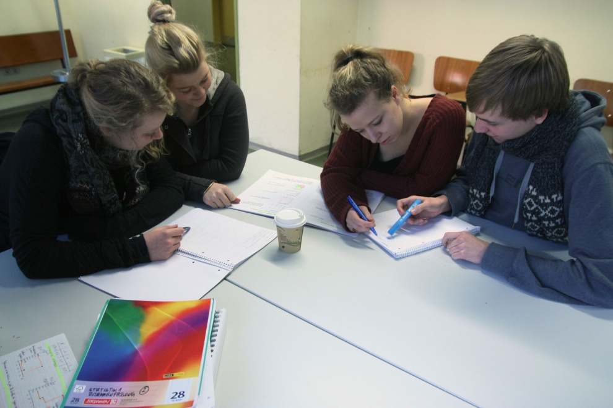
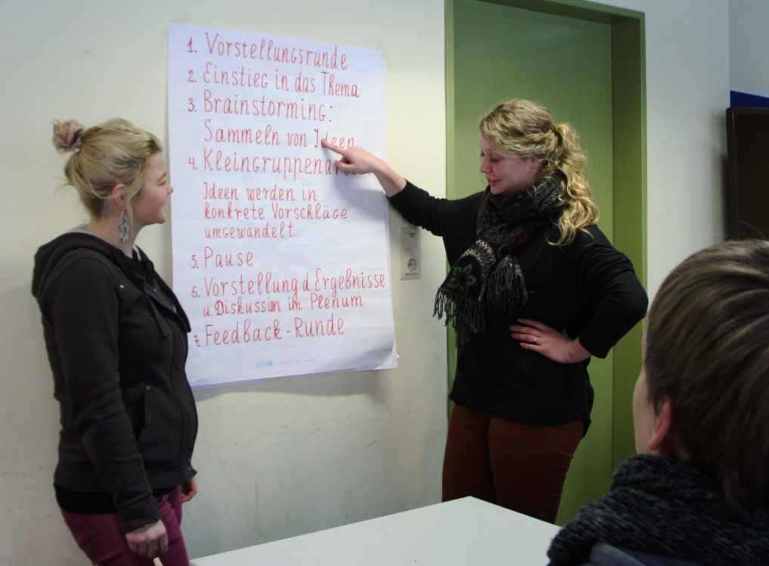
Group work
24

Slide 25
Group work: Why work in groups?
Group work has many advantages:
You learn more actively.
Work can be divided.
More ideas can be collected.
The gained knowledge can be mutually extended, controlled, and corrected.
Group work provides a supportive environment for challenging work.
You have less fear of speaking.
You have more opportunities to speak.
You will develop communication and interpersonal skills that you need in the workplace throughout your career.
Based on:
http://www.lboro.ac.uk/service/ltd/campus/grpwork.pdf
Arbeitsgruppe Hochschuldidaktische Weiterbildung an der Albert-Ludwigs-Universität 1998, Heft 6
25
Notes:
“Groups develop essential skills for use throughout your career.”

Slide 26
Group work: Key stages in group work
Group formation
Implementation of plan
Evaluation of group performance
Planning
Completion of activity
Adopted from: http://www.lboro.ac.uk/service/ltd/campus/grpwork.pdf
26

Slide 27
Group work: Key stages in group work
Group formation
Implementation of plan
Evaluation of group performance
Group planning
Completion of activity
Who is the group?
What individual strengths do you have and how can these be used effectively?
What ground rules do you need to set in order to work effectively?
Adopted from: http://www.lboro.ac.uk/service/ltd/campus/grpwork.pdf
27
Notes:
“Who is in the group?
What are your individual strengths?
How can these be used effectively?
How will the group work together? (Setting ground rules)“

Slide 28
Group work: Key stages in group work
Group formation
Implementation of plan
Evaluation of group performance
Group planning
Completion of activity
What is the aim of the group activity?
How much time do you have to do it?
Who will do what?
How will the group members communicate throughout the process?
Based on: http://www.lboro.ac.uk/service/ltd/campus/grpwork.pdf
28
Notes:
“What needs to be done?
How much time have you got to do it?
How can the work be divided amongst the group?
How will the group communicate throughout the activity?”

Slide 29
Group work: What else you can do…
Useful links:
http://learnhigher.ac.uk/Students/Group-work.html
http://www.lboro.ac.uk/service/ltd/campus/grpwork.pdf
http://www.reading.ac.uk/internal/studyadvice/StudyResources/Seminars/sta-groupwork.aspx
29

Slide 30
Presentations in the seminars
Students:
actively work out the learning contents and
provide an understanding of the subject matter to the others.
Alone or in groups
Structure
The introduction
The body
The conclusion
30

Slide 31
Presentations: Steps towards a presentation
Summarize what was read, select, structure and connect important information, look for concrete examples
6. Leading a discussion
1. Deciding on a topic
2. Searching for subject-appropriate texts
3. Reading the texts and extracting the main points
4. Conveying the central ideas in a coherent, well-structured way
5. Presenting to the plenum
Present in one‘s own language
Analyze and try to understand the content
Research and read a lot
Choose an interesting topic
31

Slide 32
Presentation: What else you can do…
Useful links:
UniComm: Dictionary of formulations http://www.mumis-unicomm.de/
LearnHigher: Preparing & Giving Presentations: http://www.brunel.ac.uk/learnhigher/giving-oral-presentations/
Study Skills (The University of Manchester): Presentations: http://www.humanities.manchester.ac.uk/studyskills/develop_learner/presentations/index.html
32

Slide 33
Written exams
33

Slide 34
Written exams: Which skills am I supposed to show?
You are supposed to show that:
you know the subject matter and
you are able to give an account of the contents in your own words.
You have to be able to explain specialist terms.
You are not only supposed to deliver statements or theses, but also give detailed reasons for your assertions.
You have to be able to transfer and apply what you have learned to related questions.
34

Slide 35
Written exams: What else you can do…
Useful links:
http://www.humanities.manchester.ac.uk/studyskills/
http://www.prepareforsuccess.org.uk/
http://und.edu/student-affairs/student-services/learning-services/skills-aids.cfm
http://www.canberra.edu.au/studyskills/learning/exams
http://services.unimelb.edu.au/__data/assets/pdf_file/0008/471284/writing-may11-Writing_essays_in_exams_Update.pdf
http://und.edu/student-affairs/student-services/learning-services/skills-aids.cfm
http://homeworktips.about.com/od/schooltests/a/instructional.htm
35

Slide 36
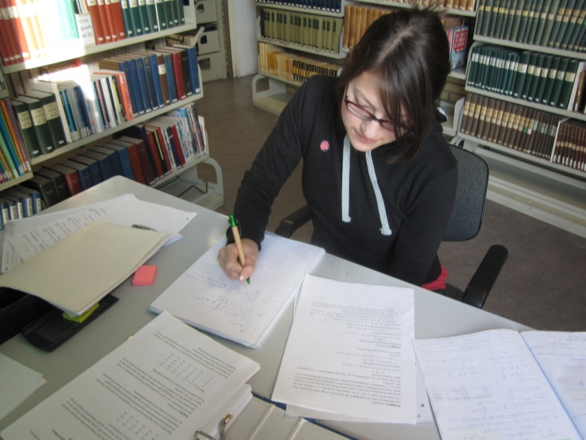
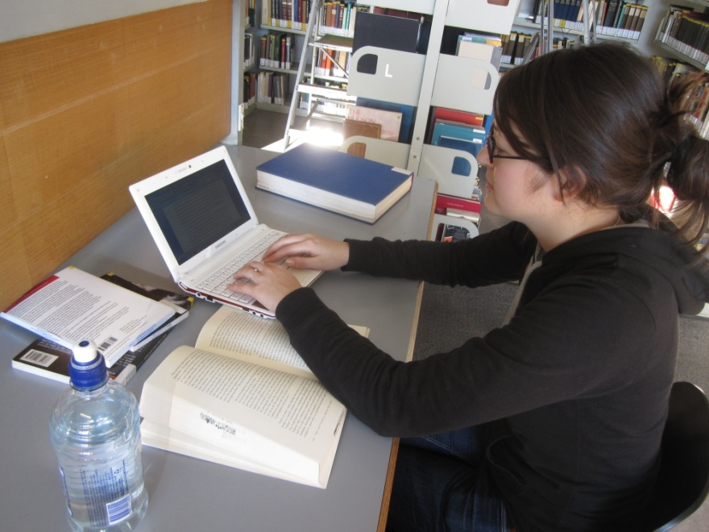
Term paper
36

Slide 37
Term paper: What does one look like?
n
<Title Page>
Title of the term paper
Name of the seminar
Name of lecturer, professor
Personal information:
Name
Matriculation number
Address and/or
Email address
<Table of Contents>
<Text>
Introduction
Body
Conclusion
< List of References / Bibliography >
37

Slide 38
Term paper: Structure of text
Introduction
Introduction to the topic
Explanation of the leading question
Description of the paper‘s structure
Body
Divided into chapters according to the structure of the subject matter and the leading question
Conclusion
Summary of the findings
Implications
Outlook
Text
Introduction
Body
Conclusion
38

Slide 39
Term paper: Why do students write a term paper?
Basis for a proof of academic achievement (exam)
Practicing for the final thesis (practicing important aspects of scientific research activities), i.e.:
Research
Scientific reasoning
The formal standards of scientific papers, etc.
Learning: A possibility
to become acquainted with a topic and
to describe one aspect of the topic in more detail.
39

Slide 40
Term paper: Writing in order to learn
Writing provides an opportunity to become familiar with a topic. It is said that you only really understood what you can also explain to others. You only really acquire what you have also managed to write about. Writing is an active, and by association, a very effective form of learning.
Writing was difficult for me but now, in hindsight of my studies, I remember the topics I wrote about the best.
Adopted and translated from: Wolfsberger 2009: 32
40

Slide 41
Term paper: Which skills am I supposed to show in my term paper?
You are supposed to show that:
you are able to describe a given topic in a problem-oriented way,
you know scientific theories and the current state of research, and
you can apply a set of scientific methods.
41

Slide 42
Term paper: Lecturers support students in writing their term papers.
In the seminars, or by means of information material, students usually get Information about:
the deadlines of their term paper,
the minimum – respectively maximum length of their paper,
how to narrow down their topic, and
what is especially important to the lecturer, etc.
42

Slide 43
Term paper: Lecturers support students in writing their term papers.
During office hours, the lecturers can give their students further support.
During office hours, students can discuss with their lecturers:
the topic, i.e. specifications of the topic,
the leading question, and
the structure etc.
Relevant questions for preparing for an office hour:
Is my leading question suitable?
Is the amount of literature appropriate?
Is the methodological approach realistic?
Is my intention realistic concerning the amount of work?
Based on: Kruse (2010: 167-168)
43

Slide 44
Term paper: Citation
What‘s that?
Extracting knowledge from other texts,
incorporating it in one‘s own textual context, and
indicating the sources.
A classic way of distinguishing between policy types is in terms of regulatory, redistributive and distributive policies (Lowi, 1964) .
An early definition by Gary Marks (1993: 392) spoke of: “the emergence of multi-level governance, a system of continuous negotiation among nested governments at several territorial tiers – supranational, national, regional and local”.
44

Slide 45
Term paper: Citation
The purpose of citation:
The verifiability of statements
Reference to prior knowledge
Marking the authorship of ideas
Plagiarism: theft of intellectual property
45

Slide 46
Term paper: What else you can do…
Useful links:
http://www2.napier.ac.uk/getready/writing_presenting/academic.html
http://www.humanities.manchester.ac.uk/studyskills/essentials/writing/index.html
Helpful academic phrases:
http://www.phrasebank.manchester.ac.uk/
46

Slide 47
End: All the best for your studies!
47

Slide 48
Bibliography
Arbeitsgruppe Hochschuldidaktische Weiterbildung an der Albert-Ludwigs-Universität 1998 Besser Lehren: Praxisorientierte Anregungen und Hilfen für Lehrende in Hochschule und Weiterbildung. Heft 4: Kommunikation in Seminaren. Weinheim: Deutscher Studien Verlag.
Arbeitsgruppe Hochschuldidaktische Weiterbildung an der Albert-Ludwigs- Universität 1998 Besser Lehren: Praxisorientierte Anregungen und Hilfen für Lehrende in Hochschule und Weiterbildung. Heft 6: Förderung studentischer Arbeitsformen, Weinheim: Deutscher Studien Verlag.
Wolfsberger, J. 2009 Frei geschrieben. Mut, Freiheit & Strategie für wissenschaftliche Abschlussarbeiten. Wien [u.a.]: Böhlau.
Kruse, O. 2010 Lesen und Schreiben. Studieren, aber richtig. Konstanz: UVK.

