Slide 1



INTERNATIONAL OFFICE
Information, Advice and Funding for
University of Kassel students
Teachers and university staff
International students
International researchers

Slide 2

Go abroad!
try new things
practice languages
discover places and cultures
make friends around the world
boost your career

Slide 3
Not sure yet?
Study credits earned abroad will be acknowledged by Universität Kassel.
Short-term stays are suitable to be organized during the semester break.
„I will have to study a semester longer if I go abroad.“

Slide 4
Not sure yet?
There are lots of scholarship programmes that apply criteria other than your grades.
In those programmes organized by the International Office, funding rates regularly exceed 90 percent.
Some programmes even guarantee a scholarship if your application is correct!
„I will never be able to finance that. Scholarships are only for high-flyers“.

Slide 5
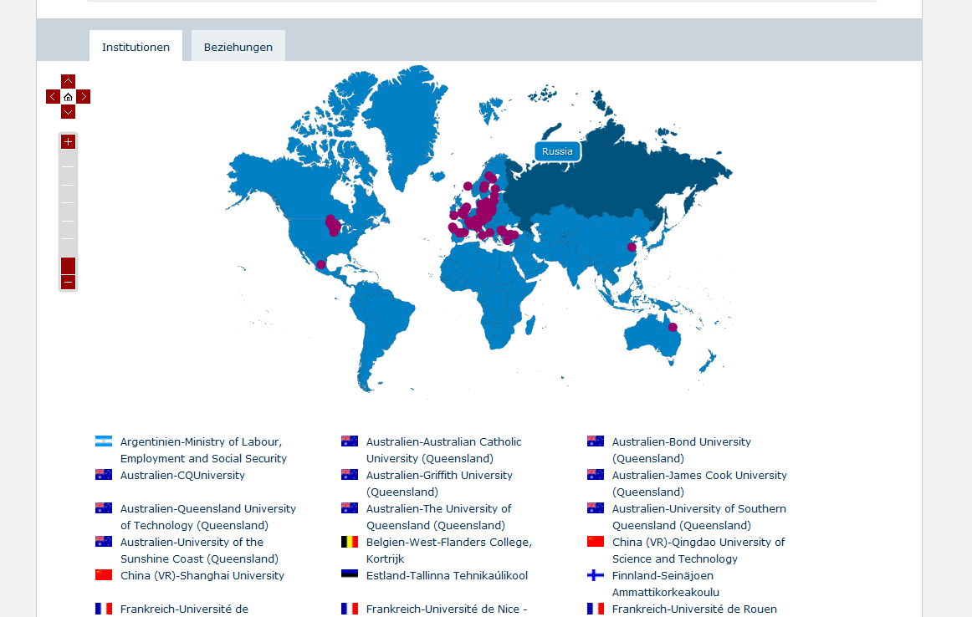
From Kassel to Everywhere
Exchange Possibilities
https://unikassel.moveon4.de/publisher/5/eng#

Slide 6
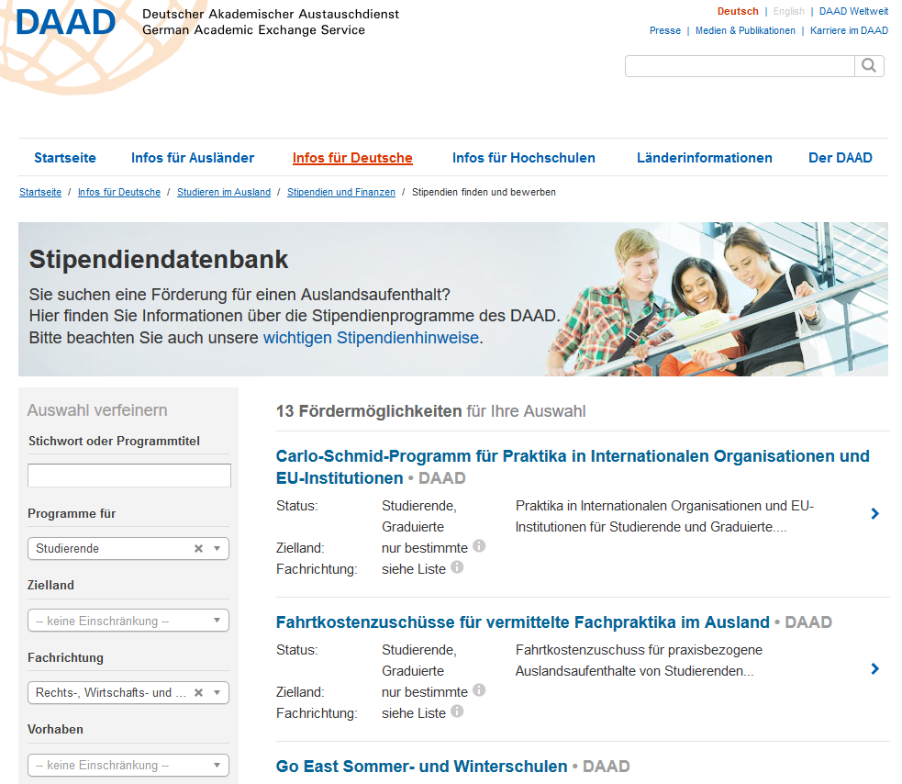
Self-organized Stays Abroad
semester abroad without programme
internships
DAAD sholarship database

Slide 7

Financing Opportunities
Erasmus+
PROMOS (DAAD)
SHOSTA (Uni Kassel)
Auslands-Bafög
student loans and study funds
DAAD scholarships
e.g. 2025€ for an Erasmus+ stay in Finland!

Slide 8
Info and Advice – personal and online
information on our website
experience reports & presentations in moodle courses
personal advice during office hours
info sessions and workshops
social media:

Slide 9
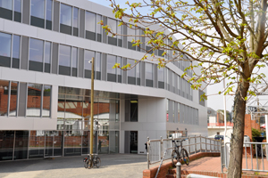
Universität Kassel
International Office
Campus Center, 2. OG
Moritzstraße 18
34109 Kassel
Phone:
0561 804-2103
International-office@uni-kassel.de
www.uni-kassel.de/go/go-international
Opening hours:
see website

